Slide 1

Lightning Network
Smart Contracts

Slide 2


Alex Melville
Software Engineer @BitGo
Digital Nomad
github.com/Melvillian

Slide 3
Main Goal: Expose you to SCRIPT Smart Contracts used in the Lightning Network Protocol
Be a Core Dev
SCRIPT Basics
Example Commitment Transaction Output SCRIPT

Slide 4



Being a Core dev is easier than ever!!
lnd (Golang)
Olaoluwa Osuntokun
https://github.com/lightningnetwork/lnd
c-lightning (C)
Rusty Russell
https://github.com/ElementsProject/lightning
eclair (Scala)
ACINQ
https://github.com/ACINQ/eclair
https://github.com/bcongdon/awesome-lightning-network

Slide 5
Lightning-related projects you can contribute to
https://github.com/bcongdon/awesome-lightning-network

Slide 6
Bitcoin’s SCRIPT
Built-in programming language for Bitcoin
OP_IF, OP_ELSE
OP_CHECKMULTISIG
OP_HASH160

Slide 7
Bitcoin’s SCRIPT
Built-in programming language for Bitcoin
OP_IF, OP_ELSE
OP_CHECKMULTISIG
OP_HASH160
No looping, so it’s not Turing-Complete

Slide 8
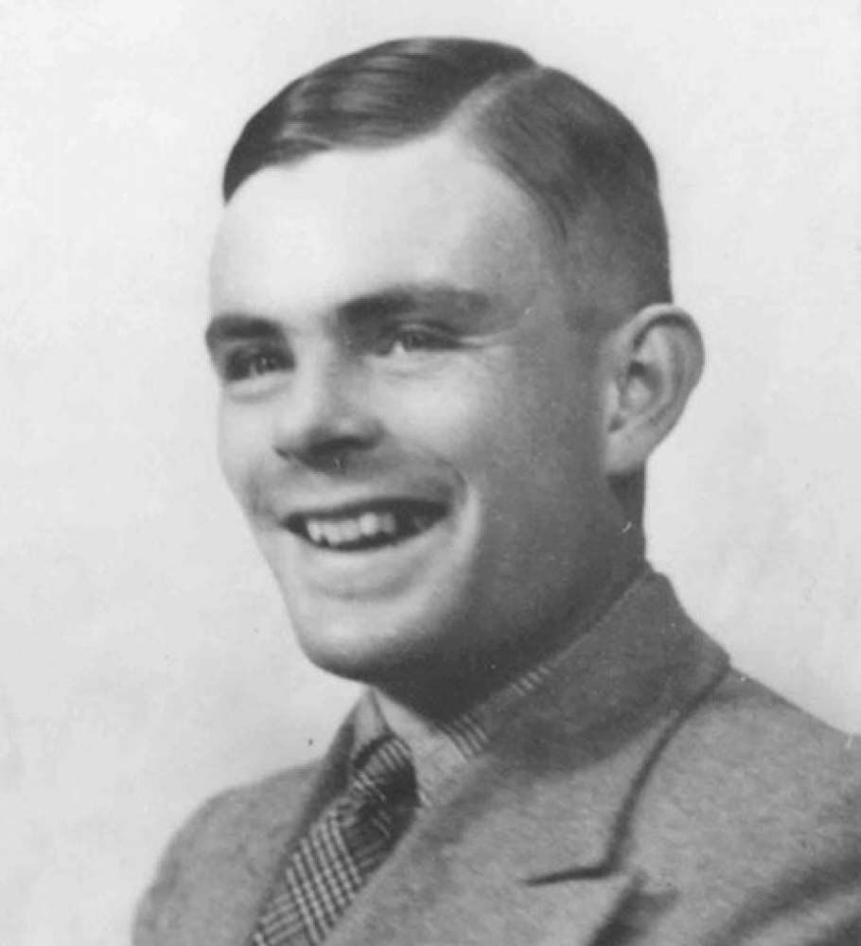
Bitcoin’s SCRIPT
But why?!
Built-in programming language for Bitcoin
OP_IF, OP_ELSE
OP_CHECKMULTISIG
OP_HASH160
No looping, so it’s not Turing-Complete
Simpler to analyze
Bounded execution

Slide 9
Bitcoin’s SCRIPT
Built-in programming language for Bitcoin
OP_IF, OP_ELSE
OP_CHECKMULTISIG
OP_HASH160
No looping, so it’s not Turing-Complete
Simpler to analyze
Bounded execution
Stack based execution model
Again, simpler to analyze
Programs feel like they’re running in reverse

Slide 10
Bitcoin’s SCRIPT
Built-in programming language for Bitcoin
OP_IF, OP_ELSE
OP_CHECKMULTISIG
OP_HASH160
No looping, so it’s not Turing-Complete
Simpler to analyze
Bounded execution
Stack based execution model
Again, simpler to analyze
Programs feel like they’re running in reverse
Used to prove ownership of UTXO’s
If you’re able to run a SCRIPT program to completion, you own the bitcoin

Slide 11
Bitcoin’s SCRIPT
Built-in programming language for Bitcoin
OP_IF, OP_ELSE
OP_CHECKMULTISIG
OP_HASH160
No looping, so it’s not Turing-Complete
Simpler to analyze
Bounded execution
Stack based execution model
Again, simpler to analyze
Programs feel like they’re running in reverse
Used to prove ownership of UTXO’s
If you’re able to run a SCRIPT program to completion, you own the bitcoin
List of OP codes
https://github.com/bitcoinjs/bitcoin-ops/blob/master/index.json

Slide 12
What does Script Look like?
OP_DUP OP_DUP OP_MUL OP_SUB OP_12 OP_EQUAL
Equivalent to
x^2 - x = 12
scriptPubKey
This is the program
Example: OP_DUP OP_DUP OP_MUL OP_SUB OP_12 OP_EQUAL
scriptSig
arguments to the program
Example: 4

Slide 13
What does Script Look like?
SCRIPT syntax is super simple, 2 types of things

Slide 14
What does Script Look like?
SCRIPT syntax is super simple, 2 types of things
Elements:
Just a piece of data, like an x86 assembly number, register, or string
4
<pubkeyHash>
<revocationKey>
4

Slide 15
What does Script Look like?
SCRIPT syntax is super simple, 2 types of things
Elements:
Just a piece of data, like an x86 assembly number, register, or string
4
<pubkeyHash>
<revocationKey>
OP codes:
A unit of execution, like an x86 assembly CPU instruction (mov, lea, push)
OP_IF
OP_DUP
OP_CHECKMULTISIGVERIFY
4
OP_DUP

Slide 16
Note: I borrowed the following SCRIPT model from Jimmy Song
https://medium.com/@jimmysong/

Slide 17
What does Script Look like?
Script
Stack
Current OP Code
4
OP_DUP
OP_DUP
OP_MUL
OP_SUB
OP_12
OP_EQUAL

Slide 18
What does Script Look like?
Script
Stack
Current OP Code
} scriptSig (the program’s arguments)
4
OP_DUP
OP_DUP
OP_MUL
OP_SUB
OP_12
OP_EQUAL

Slide 19
What does Script Look like?
Script
Stack
Current OP Code
}
} scriptSig (the program’s arguments)
4
OP_DUP
OP_DUP
OP_MUL
scriptPubKey (the program)
OP_SUB
OP_12
OP_EQUAL

Slide 20
What does Script Look like?
Script
Stack
Current OP Code
4
OP_DUP
OP_DUP
OP_MUL
OP_SUB
OP_12
OP_EQUAL

Slide 21
What does Script Look like?
Script
Stack
Current OP Code
OP_DUP
OP_DUP
OP_MUL
OP_SUB
OP_12
4
OP_EQUAL

Slide 22
What does Script Look like?
Script
Stack
Current OP Code
OP_DUP
OP_DUP
OP_MUL
OP_SUB
OP_12
4
OP_EQUAL

Slide 23
What does Script Look like?
Script
Stack
Current OP Code
OP_DUP
OP_MUL
OP_SUB
OP_12
4
OP_DUP
OP_EQUAL

Slide 24
What does Script Look like?
Script
Stack
Current OP Code
OP_DUP
OP_MUL
OP_SUB
4
OP_12
4
4
OP_EQUAL

Slide 25
What does Script Look like?
Script
Stack
Current OP Code
OP_MUL
OP_SUB
4
OP_12
4
4
OP_DUP
OP_EQUAL

Slide 26
What does Script Look like?
Script
Stack
Current OP Code
OP_MUL
4
OP_SUB
4
OP_12
4
4
OP_EQUAL

Slide 27
What does Script Look like?
Script
Stack
Current OP Code
4
OP_SUB
4
OP_12
4
OP_MUL
4
OP_EQUAL

Slide 28
What does Script Look like?
Script
Stack
Current OP Code
OP_SUB
16
OP_12
4
4
OP_EQUAL

Slide 29
What does Script Look like?
Script
Stack
Current OP Code
16
OP_12
4
OP_SUB
4
OP_EQUAL

Slide 30
What does Script Look like?
Script
Stack
Current OP Code
OP_12
4
12
OP_EQUAL

Slide 31
What does Script Look like?
Script
Stack
Current OP Code
4
12
OP_12
OP_EQUAL

Slide 32
What does Script Look like?
Script
Stack
Current OP Code
4
12
4
12
OP_EQUAL

Slide 33
What does Script Look like?
Script
Stack
Current OP Code
4
12
4
12
OP_EQUAL

Slide 34
What does Script Look like?
Script
Stack
Current OP Code
SUCCESS!!
4
1

Slide 35
Commitment Transaction Output in Lightning
Ensures a channel member can always get their funds (with some delay) if the other party disappears
OP_CSV
Ensures it can be revoked, so we can update the channel to a new state (balance)
When other party goes offline suddenly
<local_delayedsig> 0
When othe party publishes revoked tx:
<revocationsig> 1

Slide 36
Commitment Transaction Output in Lightning
Ensures a channel member can always get their funds (with some delay) if the other party disappears
OP_CSV
Ensures it can be revoked, so we can update the channel to a new state (balance)
When other party goes offline suddenly
<local_delayedsig> 0
When othe party publishes revoked tx:
<revocationsig> 1
OP_IF <revocationkey> # Penalty transaction OP_ELSE `to_self_delay`# number of blocks to delay OP_CSV OP_DROP <local_delayedkey> OP_ENDIF OP_CHECKSIG

Slide 37
Script
Stack
Current OP Code
}
<delayed_sig>
scriptSig (the program’s arguments)
}
0
OP_IF
<revocationpubkey>
OP_ELSE
<to_delay_time>
OP_CSV
scriptPubKey (the program)
OP_DROP
<delayed_pubkey>
END_IF
OP_CHECKSIG

Slide 38
Script
Stack
Current OP Code
<delayed_sig>
0
OP_IF
<revocationpubkey>
OP_ELSE
<to_delay_time>
OP_CSV
OP_DROP
<delayed_pubkey>
END_IF
OP_CHECKSIG

Slide 39
Script
Stack
Current OP Code
0
OP_IF
<revocationpubkey>
OP_ELSE
<to_delay_time>
OP_CSV
OP_DROP
<delayed_pubkey>
END_IF
<delayed_sig>
OP_CHECKSIG

Slide 40
Script
Stack
Current OP Code
0
OP_IF
<revocationpubkey>
OP_ELSE
<to_delay_time>
OP_CSV
OP_DROP
<delayed_pubkey>
END_IF
<delayed_sig>
OP_CHECKSIG

Slide 41
Script
Stack
Current OP Code
OP_IF
<revocationpubkey>
OP_ELSE
<to_delay_time>
OP_CSV
OP_DROP
<delayed_pubkey>
END_IF
<delayed_sig>
0
OP_CHECKSIG

Slide 42
Script
Stack
Current OP Code
OP_IF
<revocationpubkey>
OP_ELSE
<to_delay_time>
OP_CSV
OP_DROP
<delayed_pubkey>
0
END_IF
<delayed_sig>
OP_CHECKSIG

Slide 43
Script
Stack
Current OP Code
<revocationpubkey>
OP_ELSE
<to_delay_time>
OP_CSV
OP_DROP
<delayed_pubkey>
0
END_IF
<delayed_sig>
OP_IF
OP_CHECKSIG

Slide 44
Script
Stack
Current OP Code
<to_delay_time>
OP_CSV
OP_DROP
<delayed_pubkey>
<delayed_sig>
OP_CHECKSIG

Slide 45
Script
Stack
Current OP Code
OP_CSV
OP_DROP
<delayed_pubkey>
<delayed_sig>
<to_delay_time>
OP_CHECKSIG

Slide 46
Script
Stack
Current OP Code
OP_CSV
OP_DROP
<to_delay_time>
<delayed_pubkey>
<delayed_sig>
OP_CHECKSIG

Slide 47
Script
Stack
Current OP Code
Checks nSequence,
a field on the transaction
(oldestTx(inputs).nSequence + inputs[i].nSequence > currentBlock (if using block height based locking) or currentMedianTime (if using time based locking)
OP_DROP
<to_delay_time>
<delayed_pubkey>
<delayed_sig>
OP_CSV
OP_CHECKSIG

Slide 48
Script
Stack
Current OP Code
The input is sufficiently old
OP_DROP
1
<delayed_pubkey>
<delayed_sig>
OP_CHECKSIG

Slide 49
Script
Stack
Current OP Code
1
<delayed_pubkey>
<delayed_sig>
OP_DROP
OP_CHECKSIG

Slide 50
Script
Stack
Current OP Code
<delayed_pubkey>
<delayed_sig>
OP_CHECKSIG

Slide 51
Script
Stack
Current OP Code
<delayed_sig>
<delayed_pubkey>
OP_CHECKSIG

Slide 52
Script
Stack
Current OP Code
<delayed_pubkey>
<delayed_sig>
OP_CHECKSIG

Slide 53
Script
Stack
Current OP Code
<delayed_pubkey>
<delayed_sig>
OP_CHECKSIG

Slide 54
Script
Stack
Current OP Code
SUCCESS!!
1

Slide 55
Thanks!

